Slide 1




Insurance Data Analysis Project
By
OLUSEYE OPEOLUWA
Data Analyst

Slide 2
Insurance Data Analysis Project
Introduction to Insurance and Project Overview
What is Insurance?
Insurance is a financial product provided by insurance companies to safeguard individuals and entities against potential financial losses. These losses can arise from various unforeseen events such as accidents, natural disasters, theft, or health issues. In exchange for a premium paid by the policyholder, the insurance company commits to covering specific types of risks, thereby providing financial security and peace of mind. Project Overview
This is a company specializing in offering a variety of insurance products to its customers. The company's portfolio includes auto insurance, which covers losses or damages related to vehicles. The provided dataset contains anonymized information about the policyholders, their vehicles, and their claim histories.
This project analyzes this dataset to uncover insights that can help the company improve its services, optimize premiums, and reduce claim costs.
The company aims to enhance its auto insurance division by leveraging data analysis to:
Identify patterns in claim frequencies and amounts.
Understand the demographics and characteristics of policyholders. Develop targeted marketing strategies to attract and retain customers.
Project Brief
You are tasked with analyzing the provided dataset to help this Insurance Company achieve the above objectives. Your analysis should be thorough and provide actionable insights. Use any data analysis tool of your choice (e.g., Python, Excel, SQL, Power BI) to conduct this analysis. The project should be completed within one week. Key Questions to Answer
Claim Frequency and Amount Analysis o What are the average claim frequencies and amounts for different demographic groups (e.g., age, gender, marital status)? o Are there any specific vehicle characteristics (e.g., make, model, year) that correlate with higher claim frequencies or amounts?
Risk Assessment o Which factors (e.g., household income, education level, coverage zone) are most indicative of high-risk policyholders? o Can we identify any common characteristics among policyholders who make frequent claims?
Customer Segmentation and Marketing o What are the key characteristics of policyholders with low claim frequencies and high household incomes? o How can we segment the customer base to identify high-value customers for targeted marketing campaigns?
Demographic Analysis o How does the distribution of policyholders vary across different demographic factors (age, gender, marital status)? o Are there any noticeable trends in car usage and ownership among different demographic groups?
Geographical Analysis o How do claim frequencies and amounts vary across different coverage zones? o Are there any regional trends or patterns that should be taken into consideration for marketing or risk assessment?
Customer Behavior Insights o How does the presence of children driving affect the frequency and number of claims?

Slide 3

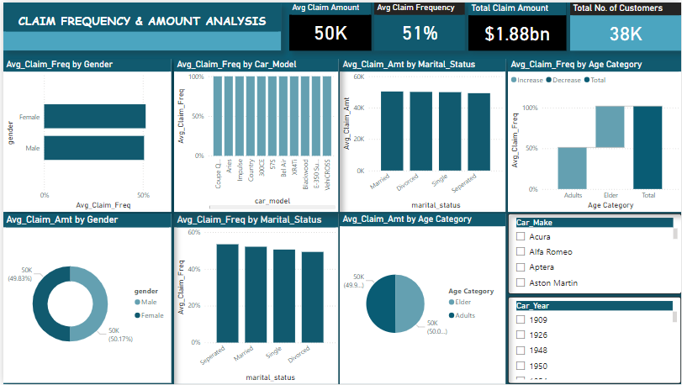
Claim Frequency & Amount Analysis

Slide 4
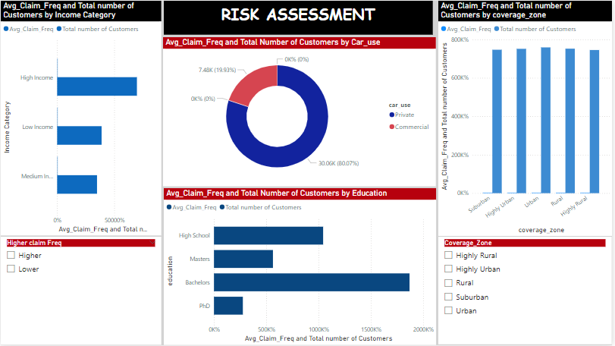
Risk Assessment

Slide 5
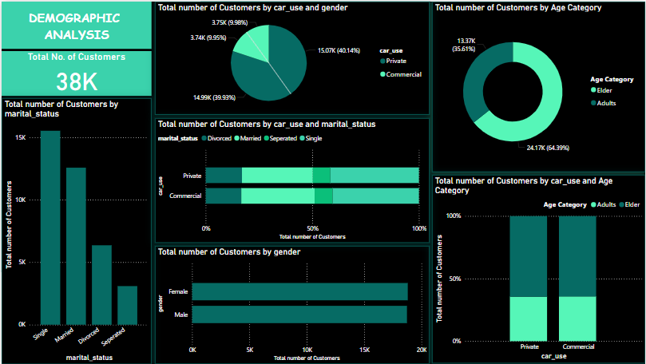
Demographic Analysis

Slide 6
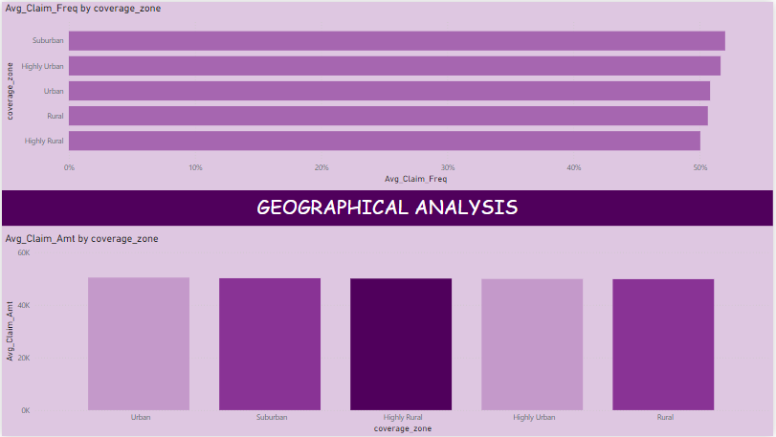
Geographical Analysis

Slide 7
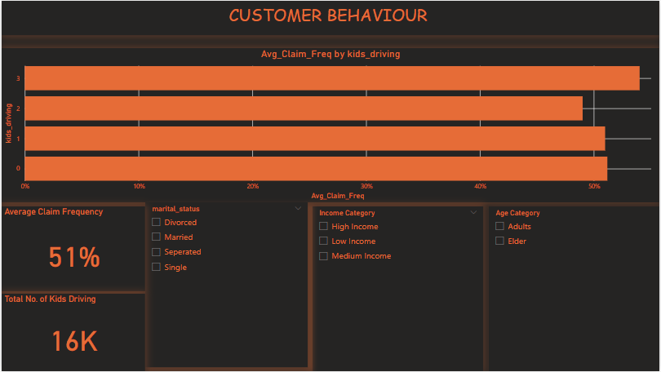
Customer Behaviors

Slide 8
Insights Recommendations
Claim Frequency and Claim Amount Analysis
The common Characteristics among policy holders who make higher frequency claims are: They are mostly bachelor degree holders, they are part of high earners in household incomes, they mostly live in the Suburban areas and Judging by the Maker of car they use, Its Ford and Chevrolet. These are the few characteristics pointed out according to the Columns used.
Risk Assessment
Average Claim Frequency and Total number of Customers are negatively correlated with each other. it means that as the total number of customers increases, the average frequency of the observed event (like claims) decreases.
As the total number of policyholders (customers) goes up, the average frequency of claims per customer tends to go down. This might mean that as the company acquires more customers, they may be attracting policyholders with lower claim frequencies on average, possibly indicating lower-risk customers joining.
a negative correlation here suggests that with a growing customer base, the average claim frequency per individual is generally reducing. This insight can be valuable for marketing, customer acquisition, and risk management strategies.
The people who make more frequent claims are Bachelors, live mostly in the Rural Areas, and drive more of Private cars.
Adjust premiums based on high-risk demographics or vehicle types, incentivizing safer options or providing discounts to low-risk groups.
Offer discounts for low-risk vehicles (like newer models with safety features) and surcharges on high-risk vehicles.
Since acquiring more customers appears to reduce average claim frequency, the company could expand marketing efforts aimed at attracting low-risk segments.
Having identify the lower claim frequencies, target them with customized offerings or incentives.
Use identified risk factors to refine underwriting criteria, applying stricter terms for high-risk profiles.
Offer tailored plans that include higher premiums or deductibles for identified high-risk groups.

Slide 9
Insights Recommendations
Customer Segmentation
policyholders with high household incomes and low claim frequencies might be valuable for retention and targeted offerings.
Low claim frequencies policy holder consist of more than 70% of the total Policy holder.
This analysis also makes us understand they live mostly in the Urban areas
The policy holders with low claim frequency are also part of those who earn high.
Customer Behavior (Kids Driving)
the presence of children driving affects claim frequency, as younger or less experienced drivers may increase the likelihood of claims.
Develop loyalty programs to retain high-value, low-claim customers, such as offering renewal discounts or additional benefits.
Tailor marketing campaigns to high-value segments, like high-income, low-risk customers, to attract similar profiles.
Consider implementing family plans that address the needs of households with young drivers, possibly with higher premiums or special coverage options.
Offer defensive driving programs or discounts to households with young drivers to encourage safer driving habits.

Slide 10
Insights Recommendations
Demographic Analysis
Single individuals represent the largest segment at 41.35% of the total customers, with 15,525 customers, which is significantly higher (402.43%) than the Separated group.
Females have a slightly higher total customer count (18,806 vs. 18,736 for males). The divergence is most notable in private vehicle usage, where females outnumber males by 82 customers.
The total number of customers follows this order: Single, Married, Divorced, Separated. This order may correlate with different usage patterns or insurance needs based on marital status.
Within the Elder age category, private car use comprises 51.59% of the total number of customers.
The average customer count is marginally higher for females (9,403) than for males (9,368).
The customer count between females and males is nearly equal, with only a difference of 70 customers. However, small variances in categories such as private vs. business use suggest nuanced preferences.
Older customers are more likely to use their vehicles privately rather than for business, possibly indicating retirees or those with reduced professional driving needs. Creating age-friendly insurance packages with benefits such as roadside assistance or discounts for low mileage could appeal to this demographic.
Married individuals are the second-largest group, potentially indicating a need for family or multi-driver plans. Divorced and Separated individuals represent smaller segments, but they may prefer individual-focused plans. Offering customized insurance products based on marital status could help increase relevance for each group.
Females might be more inclined to purchase insurance for private use rather than business, suggesting they could be more frequent users of personal vehicles. Marketing targeted at female customers may benefit from emphasizing personal, family-oriented insurance benefits or bundled packages for private usage.
While males and females have a similar overall presence, targeted campaigns can still benefit from recognizing these minor usage differences. For example, campaigns promoting private insurance options could slightly prioritize female customers, while business-use promotions might be adjusted for a more gender-neutral appeal.

Slide 11
Insights Recommendations
High Claim Frequency Zones
Suburban Zone: With an average claim frequency (Avg_Claim_Freq) of 52%, the Suburban coverage zone has the highest claim frequency. This indicates that policyholders in the Suburban zone are more likely to file claims compared to other zones, suggesting a potentially higher risk for insurers. This could be due to factors such as higher traffic density or different driving patterns commonly seen in suburban areas.
Lower Claim Frequency Zones
Highly Rural Zone: With an Avg_Claim_Freq of 50%, the Highly Rural zone has the lowest average claim frequency, which is 3.93% lower than Suburban. Policyholders in the Highly Rural zone may have lower exposure to accidents or incidents due to less congested roads and slower traffic, indicating a potentially lower-risk profile.
The other three zones fall within a narrow range of claim frequencies, between 50% and 52%. While they don't have the highest or lowest averages, they still represent a moderate risk level. These regions likely have a mix of suburban and rural characteristics, resulting in an average claim frequency near the middle of the range.
Zone-Based Pricing Model: Implement a tiered pricing structure based on coverage zones to better reflect risk differences. The Highly Rural zone could benefit from lower premiums, while Suburban zones might require slightly higher premiums due to the elevated claim frequency.
Targeted Risk Mitigation Strategies: In high-frequency zones, offer discounts on policy renewals for customers who complete driving courses or maintain low claims. Educate policyholders in Suburban areas on safer driving habits to help manage claim frequency.
Recommendation: Consider implementing risk-adjusted pricing or premium adjustments for suburban policyholders. Additionally, offering driver safety programs or promoting defensive driving courses in these areas may help reduce claim frequency over time.
Recommendation: Consider offering lower premiums or discounts to policyholders in highly rural areas. Marketing targeted toward these lower-risk zones could attract more customers by promoting the cost savings associated with lower claim frequency.
Continue monitoring these mid-range zones, as any shifts in population density or infrastructure changes could alter their risk levels. Adjust premiums accordingly if future data shows upward or downward trends in claims.
This approach allows the company to align its pricing strategy with the actual risk levels across different coverage zones, potentially reducing overall claim costs while attracting lower-risk customers in regions with lower claim frequencies.

Slide 12
Conclusion
Implementing these insights could help the insurance company better tailor its offerings, optimize risk management, and improve customer retention and acquisition efforts. The recommendations can form the basis for strategic initiatives that enhance profitability while providing policyholders with value-based services.

